Slide 1
LAMP – Team 15
Amelia Enderle, Anthony Ionita,
Lucas McClean, Lydia Rinderknecht, & Ravi Yarlagadda

Slide 2
Team 15
Our Team
Project Manager
Lucas McClean
Database Developers
Amelia Enderle, Ravi Yarlagadda
API Developer
Lydia Rinderknecht
Frontend Developer
Anthony Ionita

Slide 3
Team 15
Technologies Used
Mermaid
Neovim
cURL
Plain text graph generation tool.
“Hyperextensible Vim-based text editor”
Best editor in existence
Outperforming Postman since ‘98.
Used to create our diagrams (Gantt, ERD, and UCD).
Used for editing code on the remote server.
Used for quick-testing endpoints from the remote server.

Slide 4

Team 15
How We Used AI
Opencode Harness
Used for context-aware review, refactoring, and debugging.
ChatGPT
Used to help with CSS styling, div tags, constructing HTML drop down menus and User/Contacts search list result messages. Also used for debugging JavaScript file and for general questions.
Review
Provide review and recommendations based on project’s state and supplied goals.
Refactoring
Made simple changes that required many updates.
Debugging
Help troubleshoot tricky issues that may have to do with environmental problems.

Slide 5
Team 15
What Worked
Setting up the LAMP stack was fairly easy
Testing endpoints with Postman was seamless
The flow from DB to API to frontend was relatively simple
Setting up DB with using the base from the tutorial was effortless

Slide 6
Team 15
What Didn’t
Versioning between local copies, GitHub, and the remote server
Syncing the remote server could be a pain
Managing the database without a migration tool

Slide 7
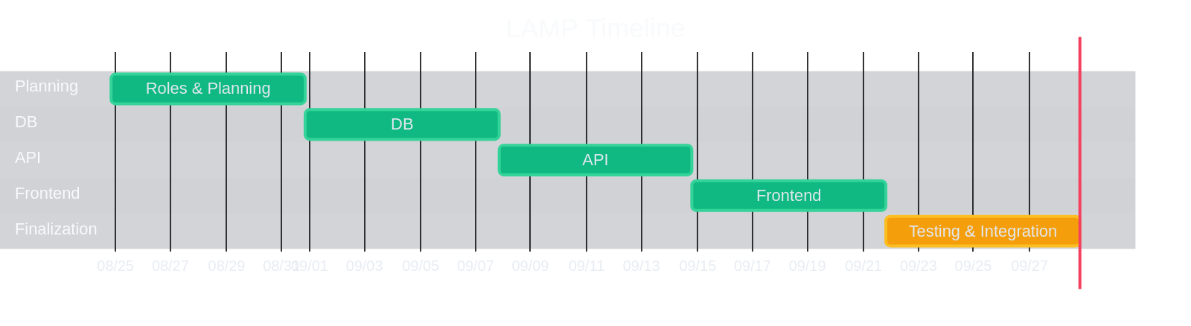
Team 15
Gantt Chart
Our Development Timeline

Slide 8
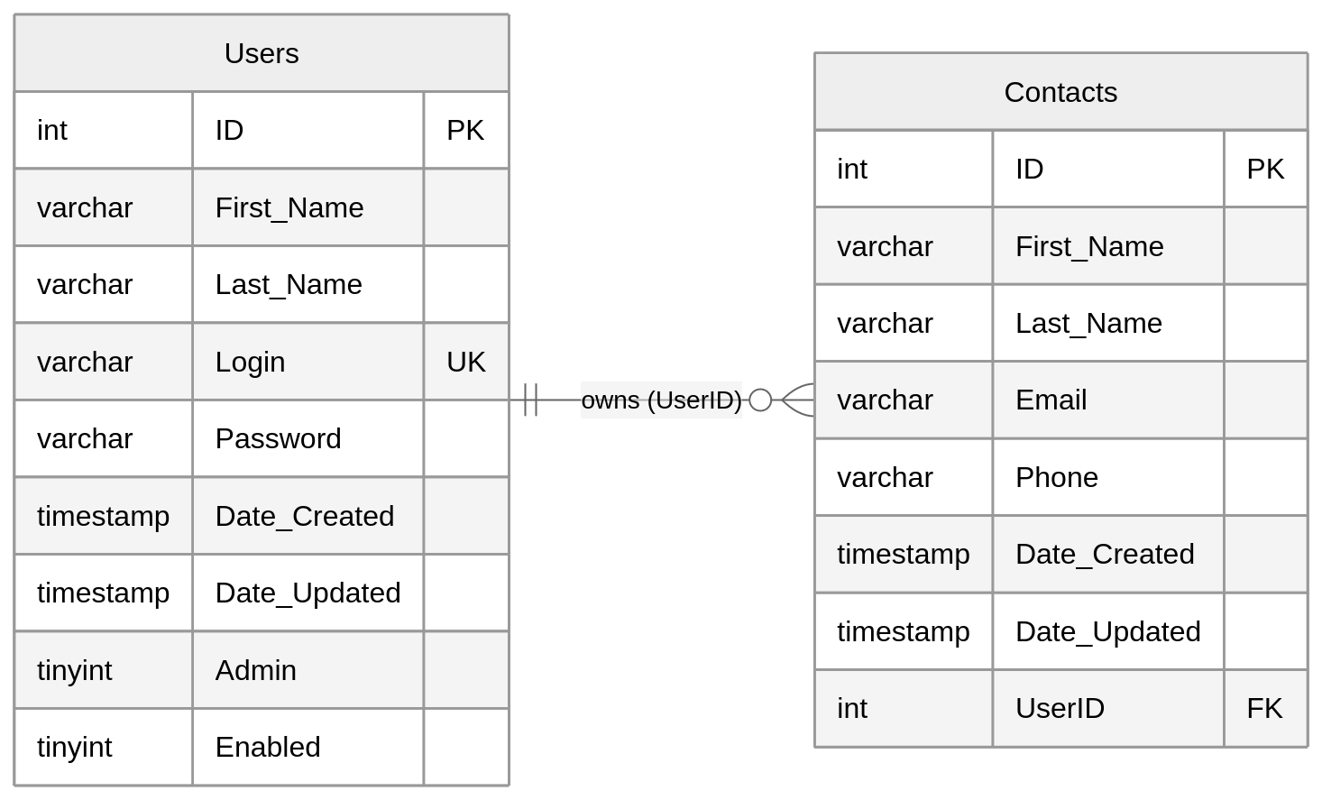
Team 15
ERD
Entity Relationship Diagram

Slide 9
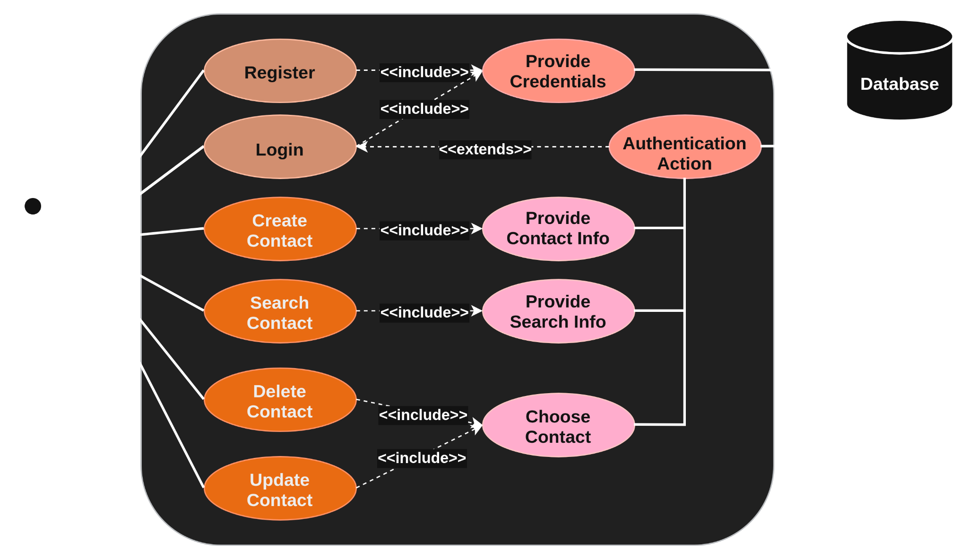
Team 15
Use Case Diagram
User UML

Slide 10
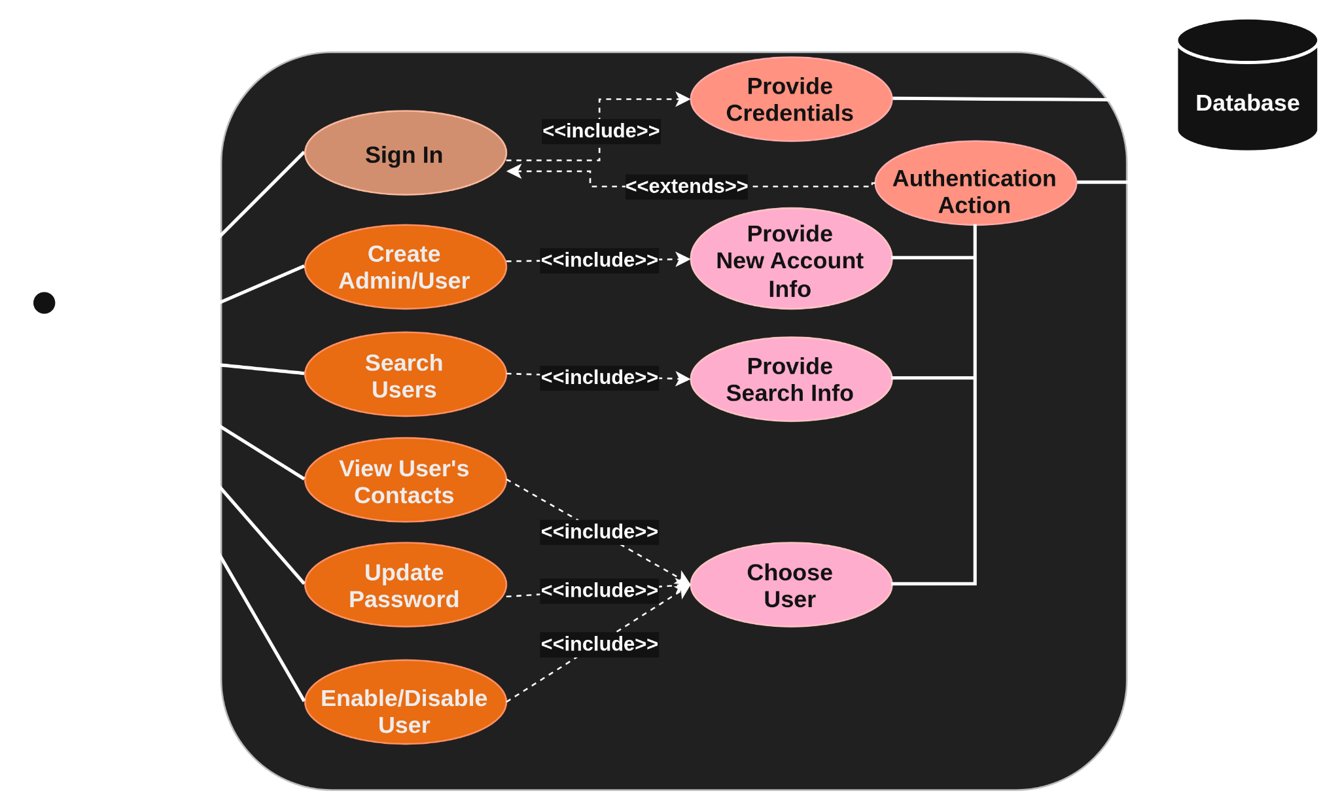
Team 15
Use Case Diagram
Admin UML

Slide 11
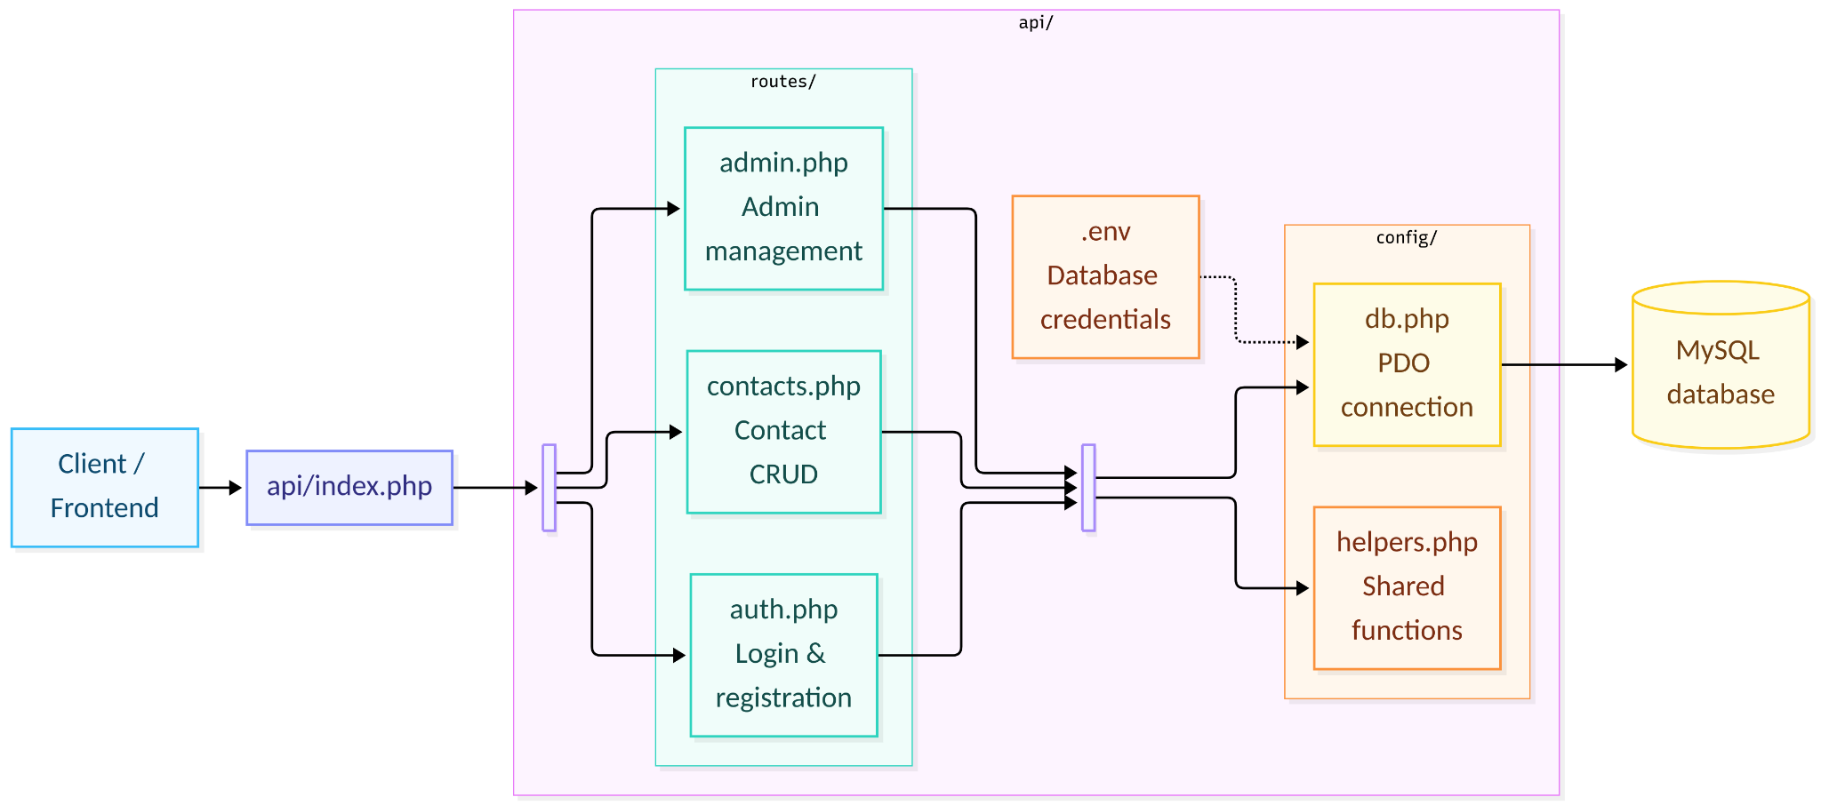
API Architecture
Team 15

Slide 12
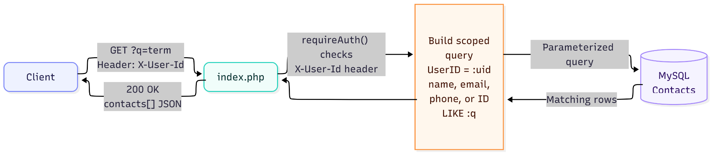
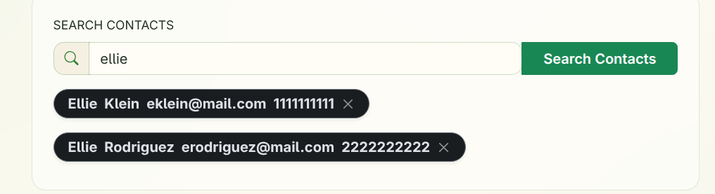
Request Flow: Contact Search
Team 15

Slide 13
Live Demo
Team 15

